Slide 1
A Project Submitted in Partial Fulfillment of the Requirements of Passing for the Course of CSI 382 - Data Mining and Knowledge Discovery

Slide 2
Team Participants
Angraj MD Sargia Showrav
CSE 06607820
Sajib Kotal
CSE 06607811
Mohammad Ahmedullah
CSE 06607837

Slide 3
Objective
In this project we are trying to do some predictions on the Bank Marketing Data set to predict the If a client will subscribe a term deposit or not.

Slide 4
Goal
The classification goal is to predict if the client will subscribe a term deposit-
1) yes
2) no

Slide 5
Introduction
We are given the data of direct marketing campaigns (phone calls) of a Portuguese banking institution. The classification goal is to predict if the client will subscribe a term deposit (target variable y). This case study is inspired by this research paper where the researchers have used a very similar dataset as the one we will be using throughout this case study for determining the success of Bank Telemarketing

Slide 6
About the Dataset
The dataset consists of direct marketing campaigns data of a banking institution. The dataset was picked from UCI Machine Learning Repository . There were four variants of the datasets out of which we chose “ bank-additional-full.csv” which consists of 41188 data points with 20 independent variables out of which 10 are numeric features and 10 are categorical features. The list of features available to us are given below:

Slide 7
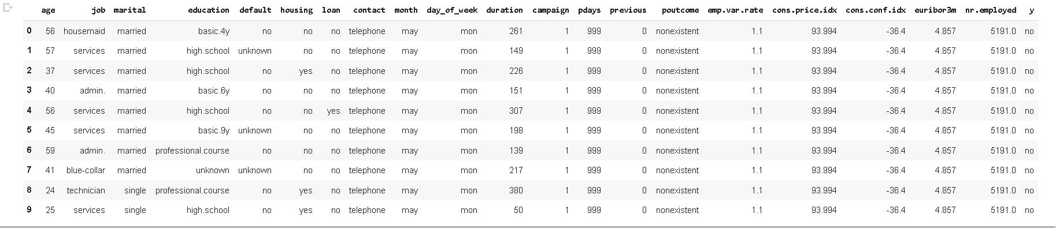
Data set Information

Slide 8
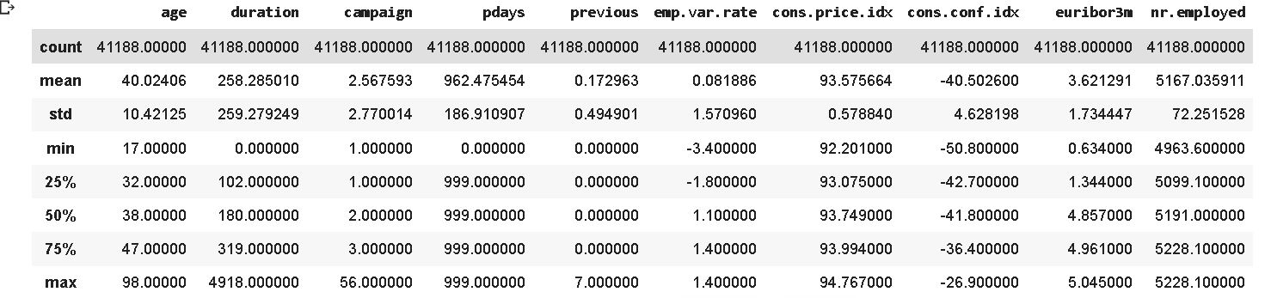
Data set Information

Slide 9
Data pre processing
As we have measured some of the attributes ar lesser concern we will be eliminating them as we have a huge dataset to measure. We have to do some pre-processing to those data.
1.contact
2.day_of_week
3.month
4.default
5,.pdays

Slide 10
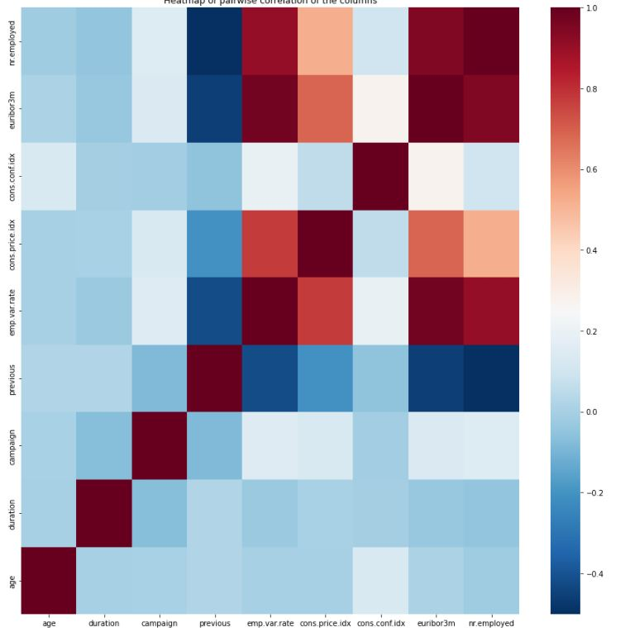
Exploraory data analysis Correlated Variables

Slide 11
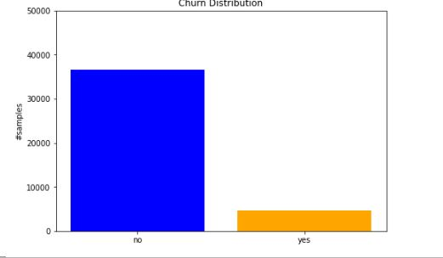
Exploring categorical variables
We can see from the above plot that the dataset in imbalanced, where the number of negative class is close to 8 times the number of positive class.

Slide 12
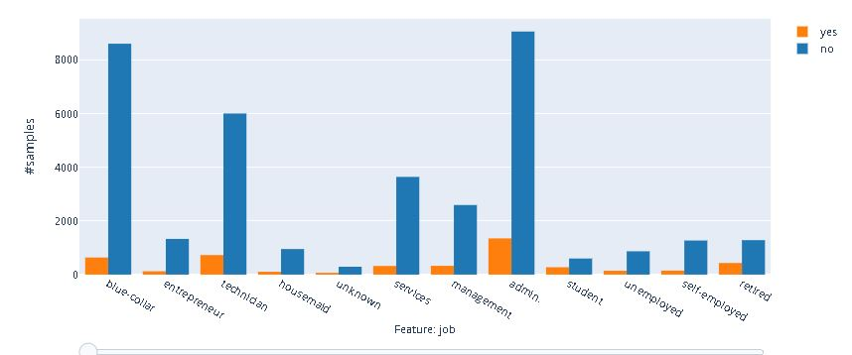
From the above plot, we can see that the customers who have a job of admin have the highest rate of subscribing a term deposit, but they are also the highest when it comes to not subscribing. This is simply because we have more customers working as admin than any other profession.

Slide 13
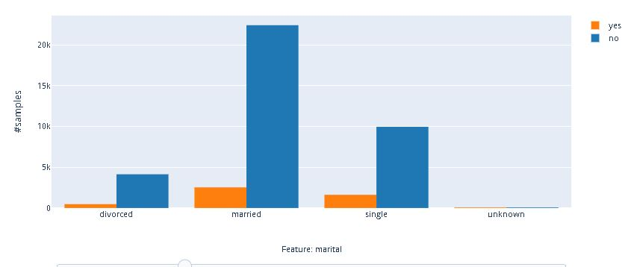
Majority of the customers are married. Followed by Single, divorced and unknown.

Slide 14
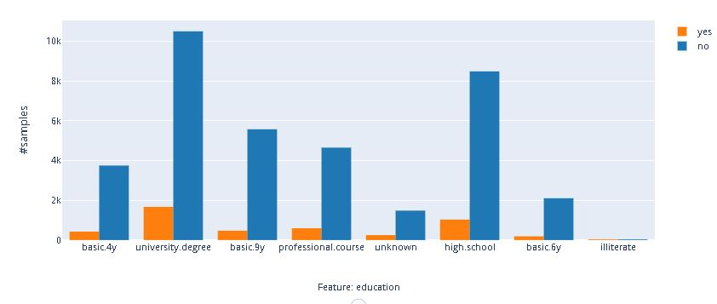
we can see that majority of the unversity degree holder clients have a subscription also they have the negative percentage also.

Slide 15
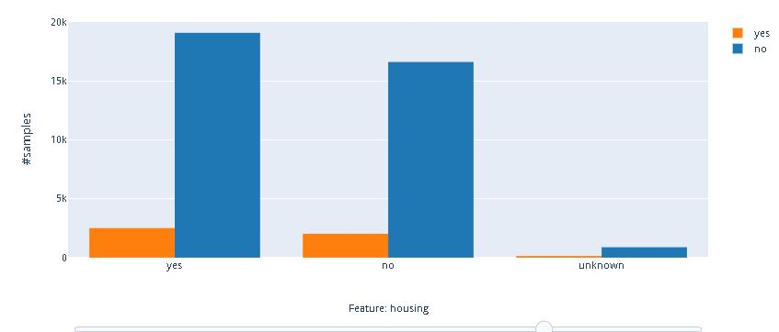
As we can see from the above plot, majority of the customers have a housing loan.

Slide 16
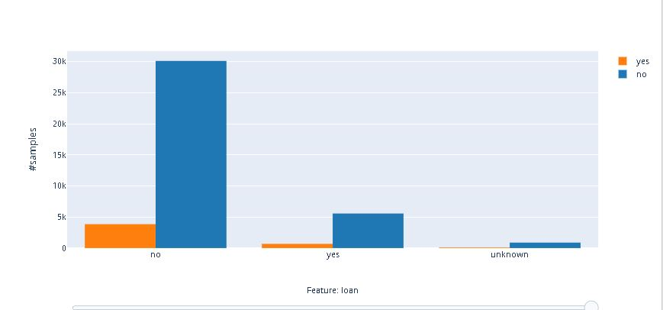
As we can see majority of the clients dont have a housing loan

Slide 17
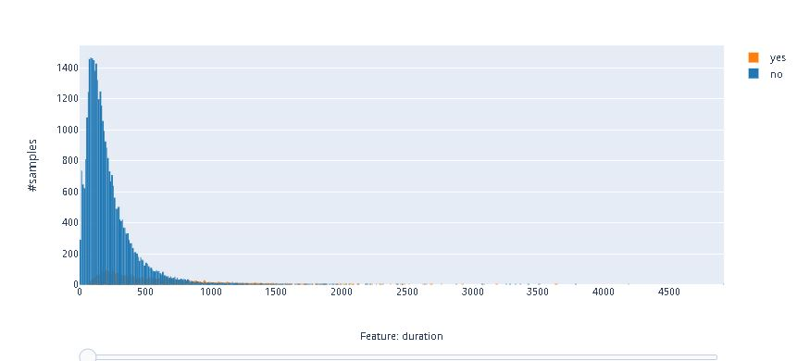
EXPLORING NUMERICAL VARIABLES

Slide 18
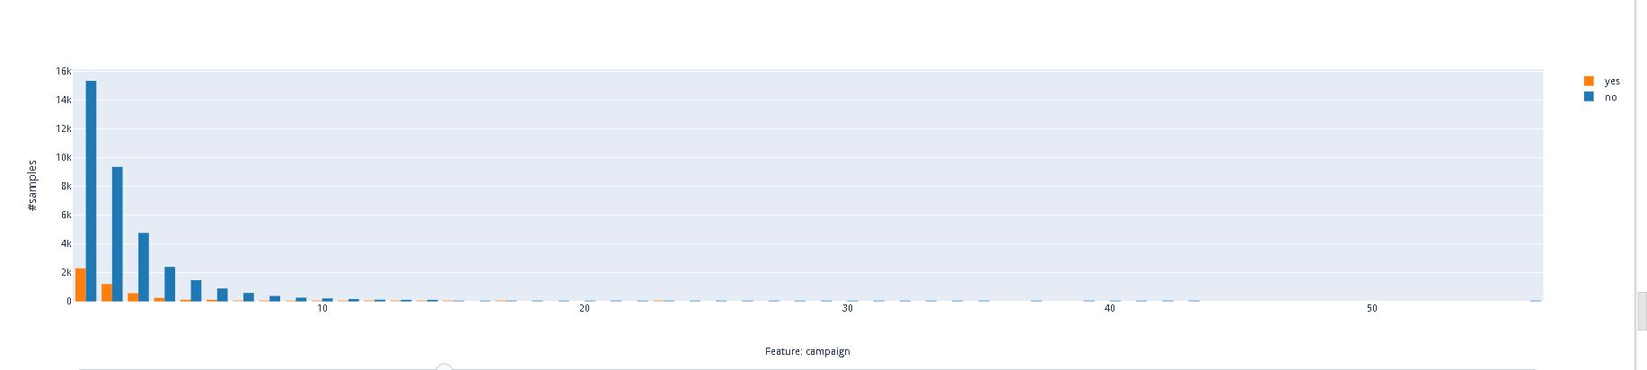

Slide 19
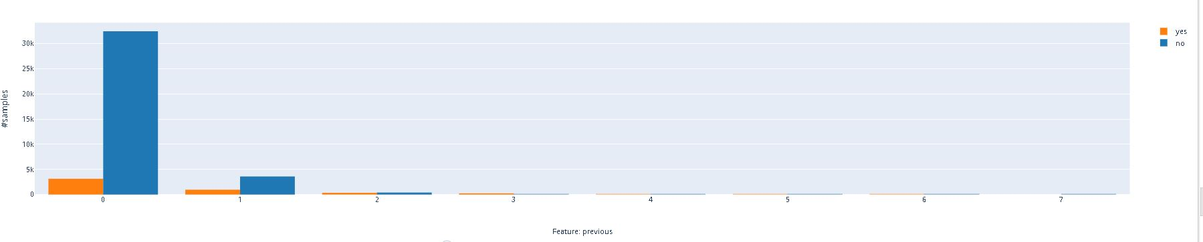

Slide 20
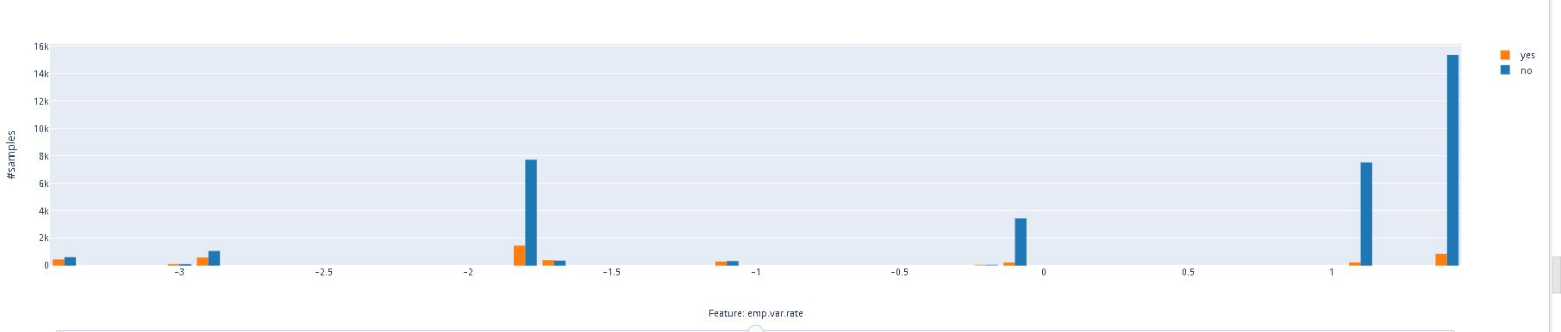

Slide 21
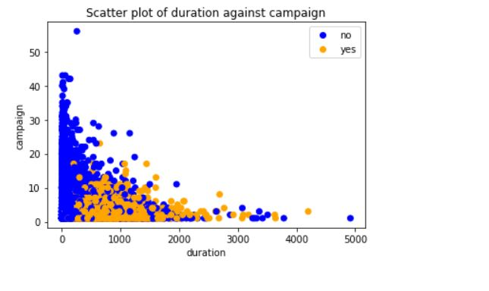
EXPLORING MULTIVARIATE RELATIONSHIPS

Slide 22
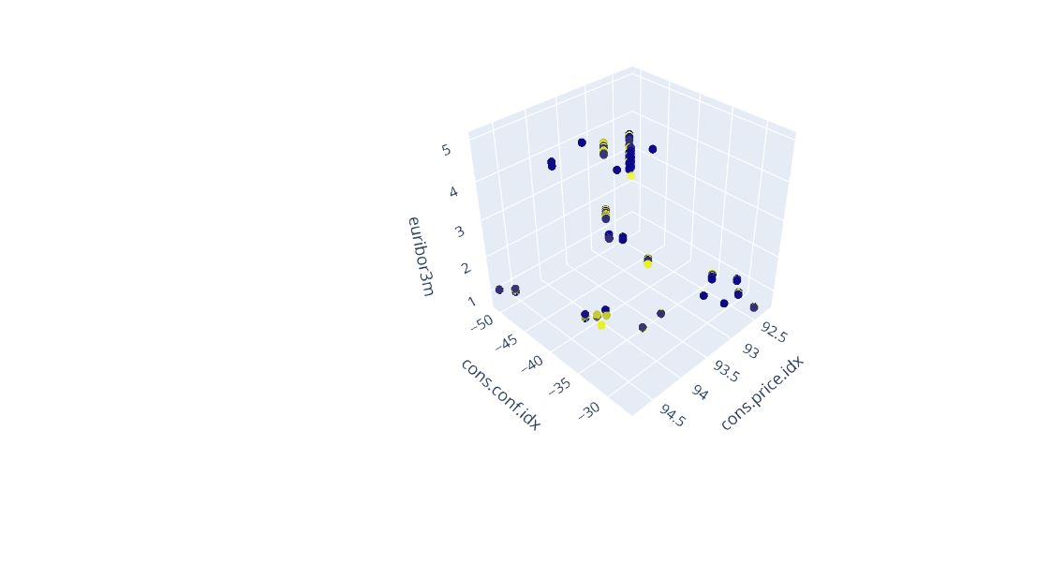
3d scatterplot

Slide 23
Statistical Approaches to Estimation and Prediction
If estimation and prediction are considered to be data mining tasks, statistical analysts have been performing data mining for over a century. In this lab we will be examining :
univariate methods
statistical estimation
prediction methods
These methods include point estimation and confidence interval estimation. Next we will consider simple linear regression, where the relationship between two numerical variables is investigated. Finally, we will examine multiple regression, where the relationship between a response variable and a set of predictor variables is modeled linearly.

Slide 24
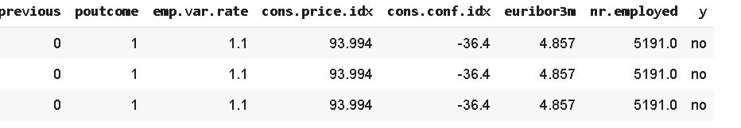
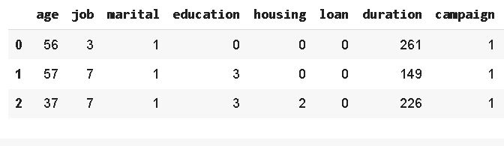

Slide 25
UNIVARIATE METHODS: MEASURES OF CENTER AND SPREAD
Center describes a typical value of a data point. Two measures of center are mean and median. Spread describes the variation of the data. Two measures of spread are range and standard deviation.

Slide 26
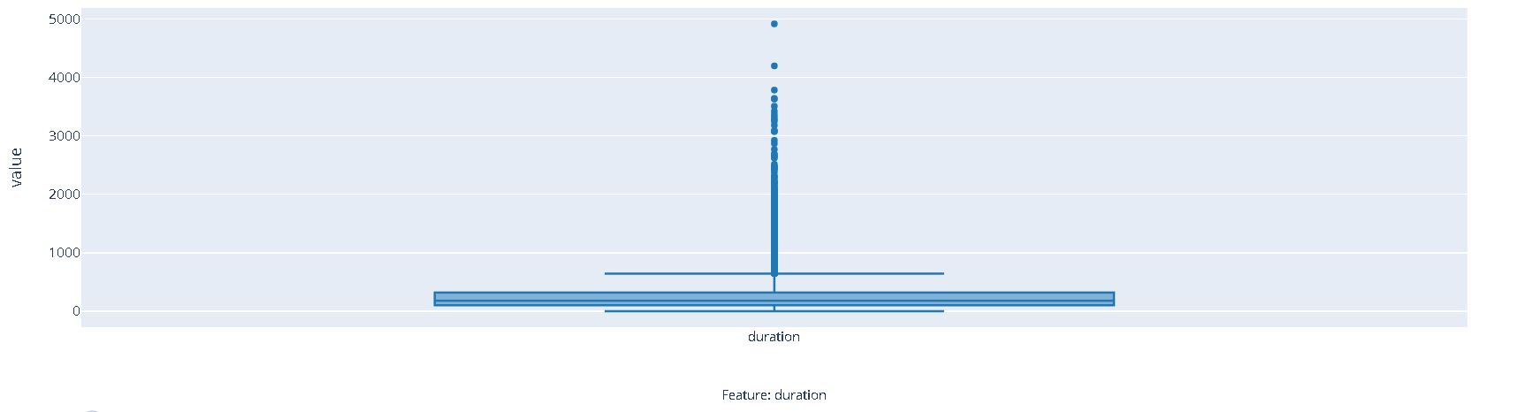

Slide 27
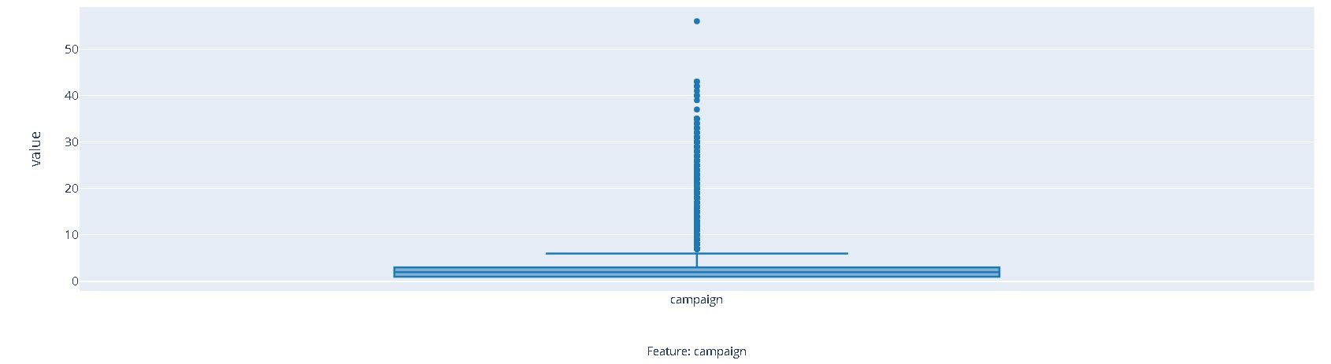

Slide 28
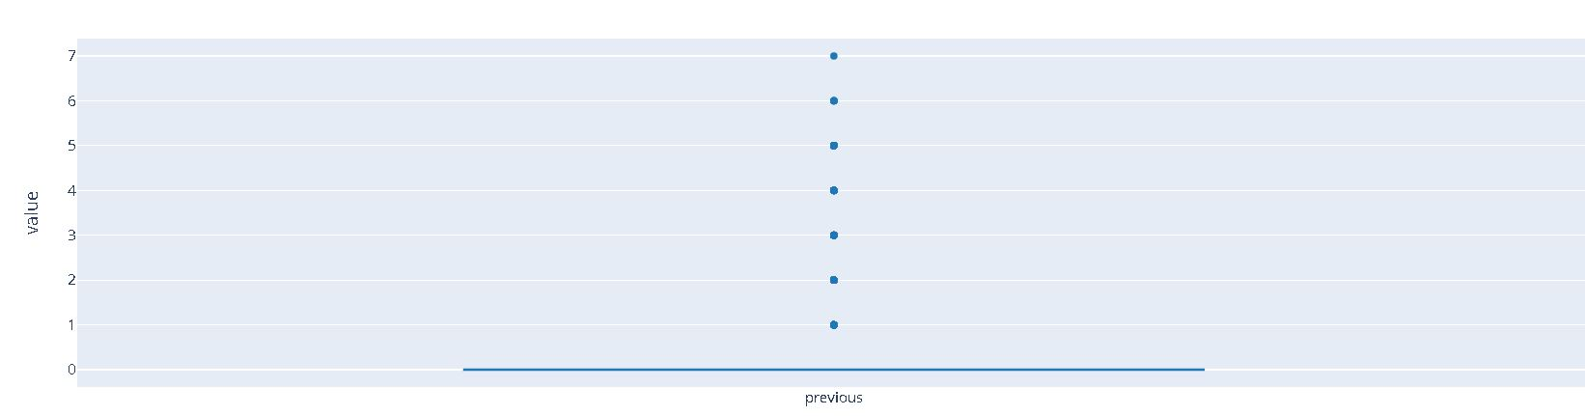

Slide 29
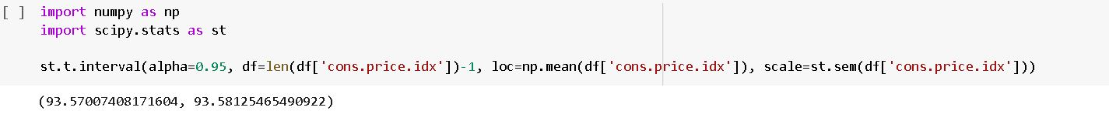
Estimation Confidence Interval Estimate
we are 95% confident that the population mean number of cons.price.idx for all data falls between 93.93.57007408171604 and 93.58125465490922

Slide 30
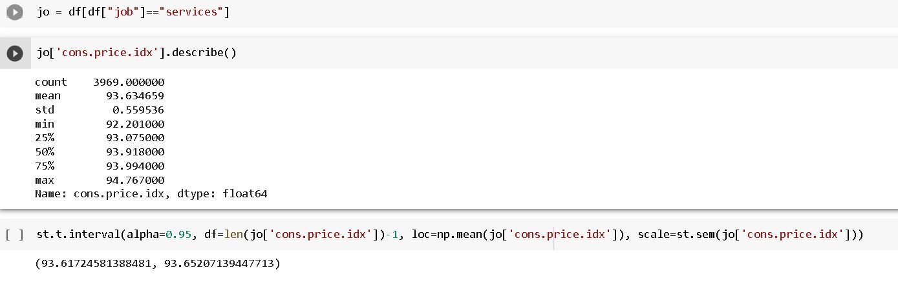
We are 95% confident that the mean number of cons.idx.price for all services job falls between 93.61724581388481 and 93.65207139447713

Slide 31
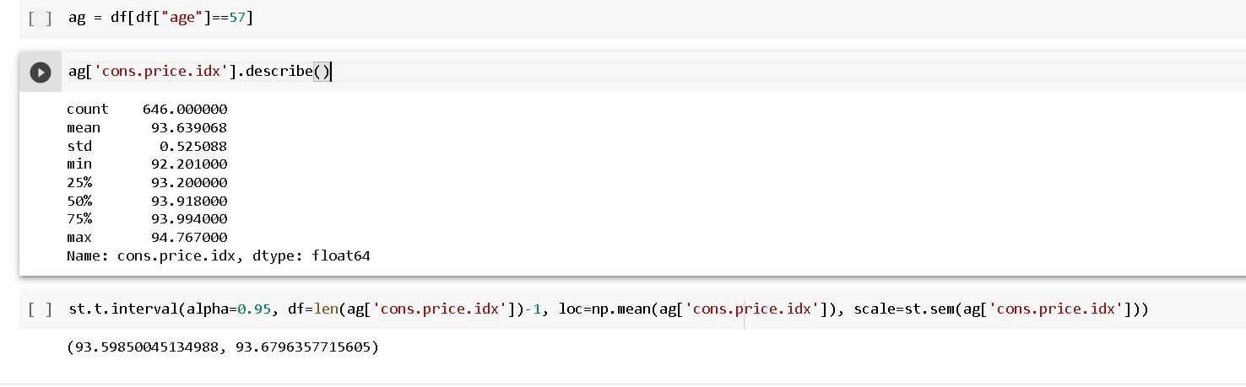
we are 95 % sure that the mean number of 57 age falls between 93.59850045134988 and 93.6796357715605

Slide 32
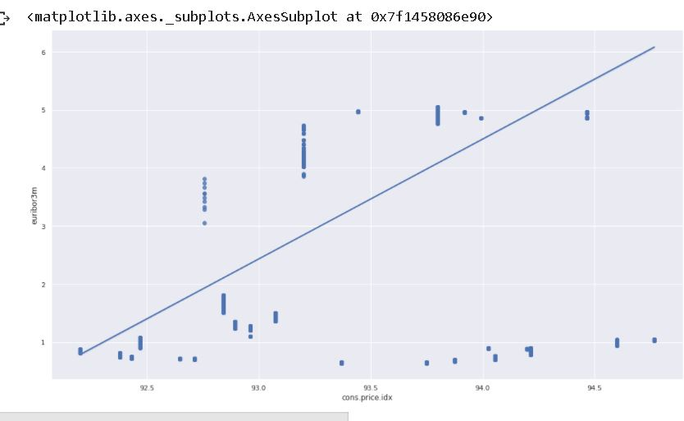
BIVARIATE METHODS Regression - Calculation

Slide 33
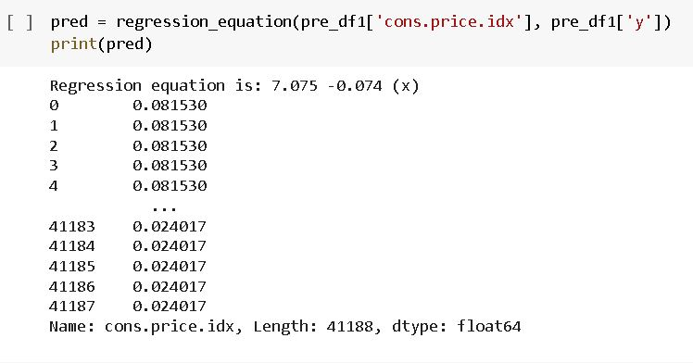

Slide 34
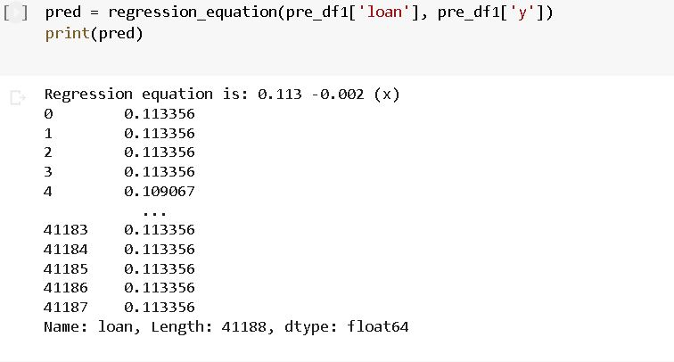

Slide 35
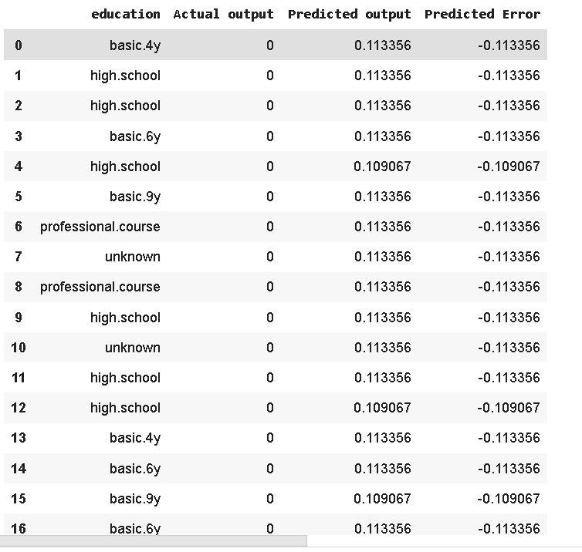
Residuals

Slide 36
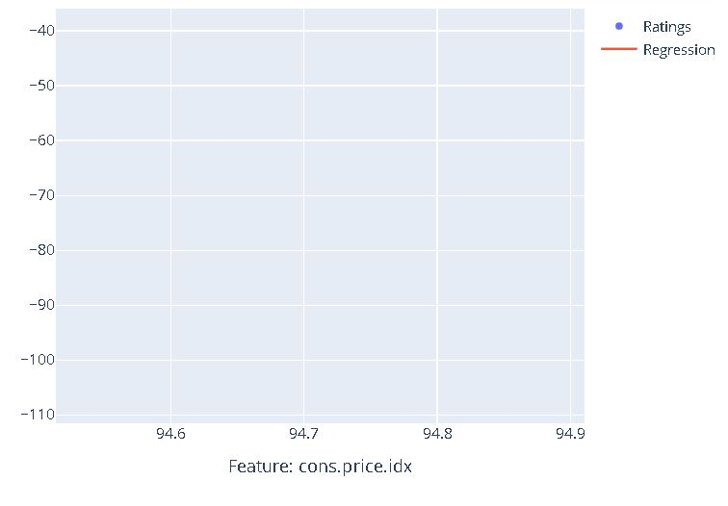
New Prediction

Slide 37
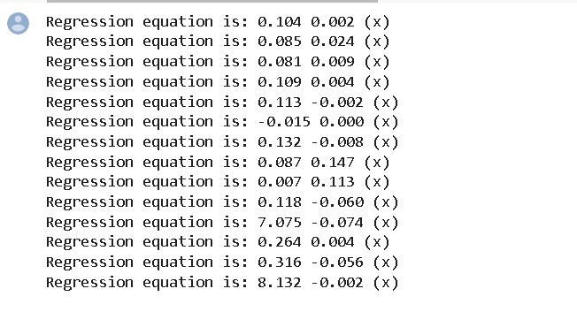
MULTIPLE REGRESSION

Slide 38
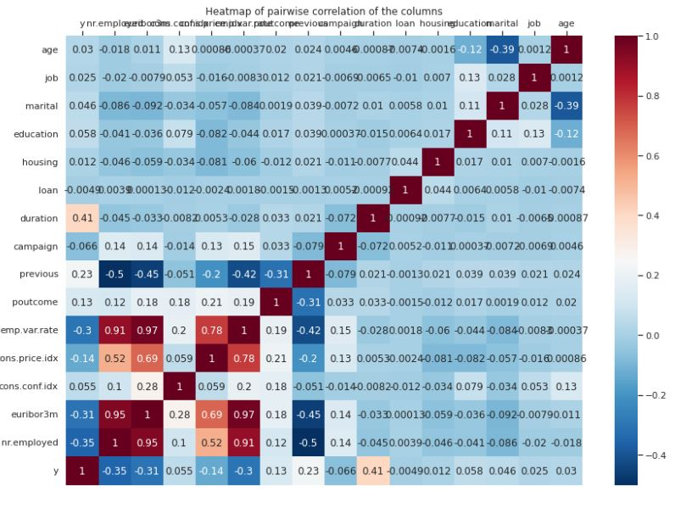
Correlation Coefficients

Slide 40
k-Nearest Neighbor Algorithm
k-nearest neighbor algorithm, which is most often used for classification, al- though it can also be used for estimation and prediction. k-Nearest neighbor is an example of instance-based learning, in which the training data set is stored, so that a classification for a new unclassified record may be found simply by comparing it to the most similar records in the training set.

Slide 41
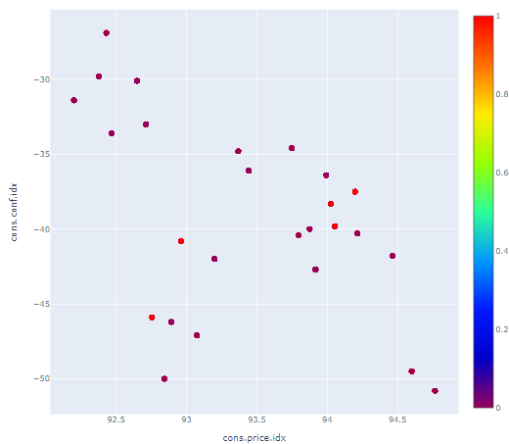
k-nearest neighbor using scatter plot

Slide 42
After Adding two record

Slide 43
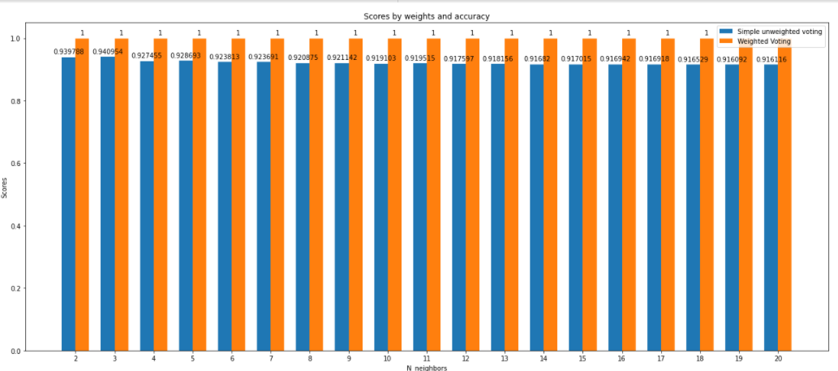
Running the model We will run our model in different scenarios. The scenarios are as follows: Scenario 1 –

Slide 44
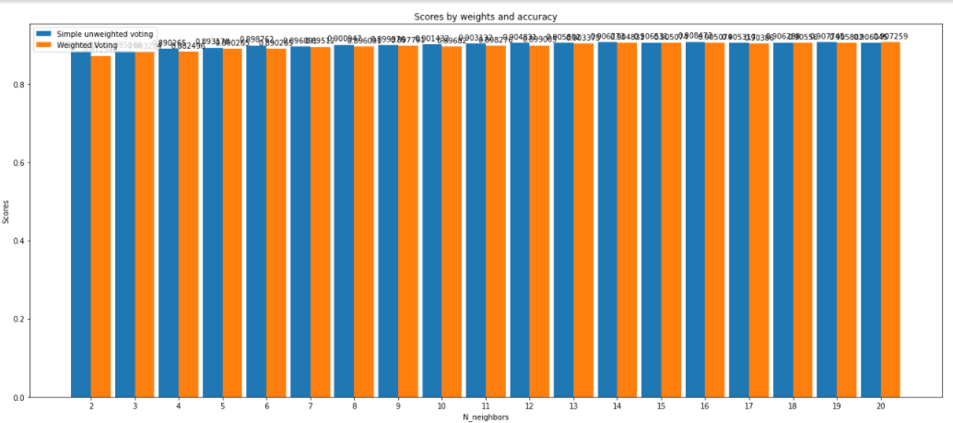
Scenario 2 -

Slide 45
Decision Tree
One attractive classification method involves the construction of a decision tree, a collection of decision nodes, connected by branches, extending downward from the root node until terminating in leaf nodes. Beginning at the root node, which by convention is placed at the top of the decision tree diagram, attributes are tested at the decision nodes, with each possible outcome resulting in a branch. Each branch then leads either to another decision node or to a terminating leaf node.

Slide 46
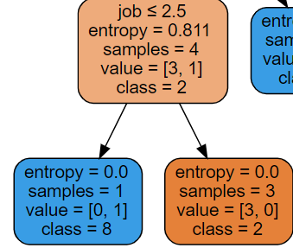
Decision Tree – CART

Slide 47
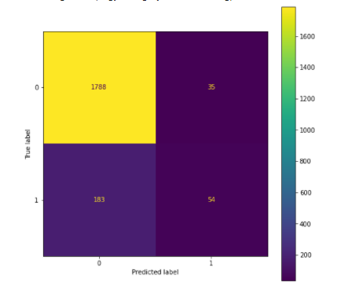
Calculating a Confusion Matrix of CART algorithm

Slide 48
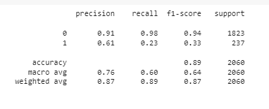
Support and Confidence of CART algorithm

Slide 49
Decision Tree - C4.5
The C4.5 algorithm is Quinlan’s extension of his own ID3 algorithm for generating decision trees \cite{10.5555/152181}. Just as with CART, the C4.5 algorithm recursively visits each decision node, selecting the optimal split, until no further splits are possible. However, there are interesting differences between CART and C4.5:
Unlike CART, the C4.5 algorithm is not restricted to binary splits. Whereas CART always produces a binary tree, C4.5 produces a tree of more variable shape.
For categorical attributes, C4.5 by default produces a separate branch for each value of the categorical attribute. This may result in more “congested” than desired, since some values may have low frequency or may naturally be associated with other values.

Slide 50
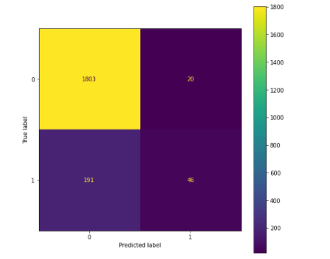
Calculating a Confusion Matrix of C4.5 algorithm

Slide 51
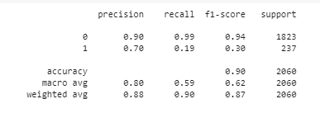
Support and Confidence of C4.5algorithm

Slide 52
Neural Networks
Neural networks are used for effective data mining in order to turn raw data into useful information. Neural networks look for patterns in large batches of data.
Frist, we normalize our data set for this neural model

Slide 53
A Neural Network is made up of 3 components:
Input Layer.
Hidden Layers.
Output Layer.

Slide 54
Sigmoid Activation Function
A weighted sum of inputs is passed through an activation function and this output serves as an input to the next layer.
Activation functions are a critical part of the design of a neural network. The choice of activation function in the hidden layer will control how well the network model learns the training dataset. The choice of activation function in the output layer will define the type of predictions the model can make
Now we calculate an input for neuron activation.
y=1(1+e−a)

Slide 55
Fold: Divided our data set in some fold ,some fold for training and 1 fold for testing. Fold change randomly.
Learning rate: The learning rate is a hyper parameter that controls how much to change our model in response to the estimated error each time the model weights are updated. The learning rate the most important hyper parameter when configuring your neural network.
Epoch: An epoch means training the neural network with all the training data for one cycle. A forward pass and a backward pass together are counted as one pass. We use a part of the dataset to train the neural network.
Hidden layer: A hidden layer neural network is a layer in between input layers and output layers, where artificial neurons take in a set of weighted inputs and produce an output through an activation function.

Slide 56
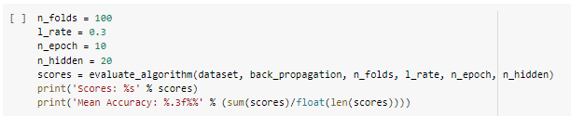

Slide 57


Slide 58
k-means Clustering
Clustering refers to the grouping of records, observations, or cases into classes of similar objects. A cluster is a collection of records that are similar to one another and dissimilar to records in other clusters.
Instead, clustering algorithms seek to segment the entire data set into relatively homogeneous subgroups or clusters, where the similarity of the records within the cluster is maximized, and the similarity to records outside this cluster is minimized.

Slide 59
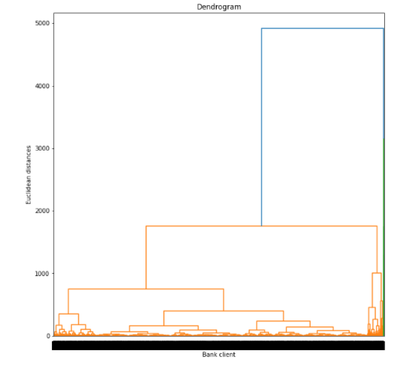
Hierarchical Clustering Methods

Slide 60
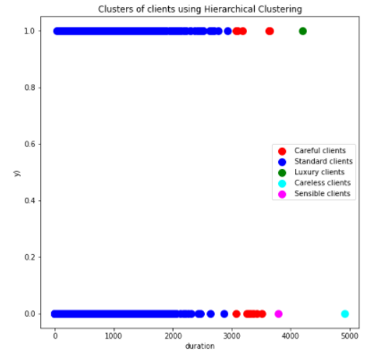
Single linkage

Slide 61
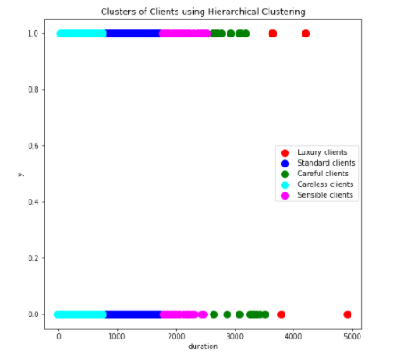
Complete linkage

Slide 63
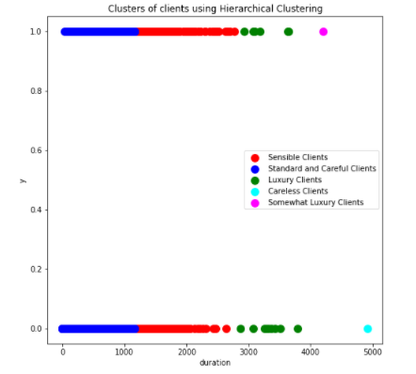
Average linkage

Slide 64
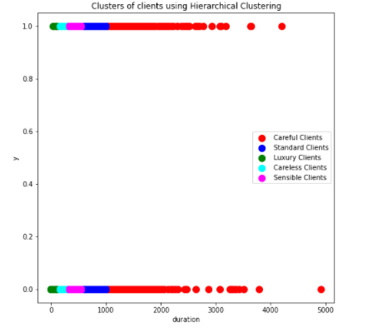
Ward linkage

Slide 65
k-means Clustering
The k-means clustering algorithm [2] is a straightforward and effective algorithm for finding clusters in data. The algorithm proceeds as follows.
Step 1: Ask the user how many clusters k the data set should be partitioned into.
Step 2: Randomly assign k records to be the initial cluster center locations.
Step 3: For each record, ﬁnd the nearest cluster center. Thus, in a sense, each cluster center “owns” a subset of the records, thereby representing a partition of the data set. We therefore have k clusters, C1, C2,…,Ck.
Step 4: For each of the k clusters, find the cluster centroid, and update the location of each cluster center to the new value of the centroid.
Step 5: Repeat steps 3 to 5 until convergence or termination.

Slide 66
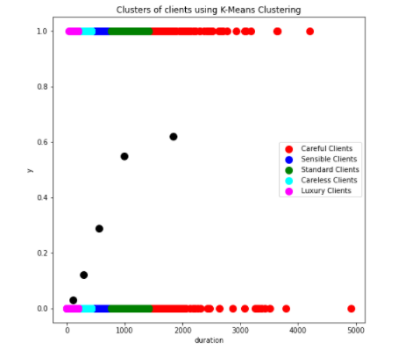
k-means Clustering

Slide 67
Model Evaluation
Model evaluation plays a crucial role while developing a predictive machine learning model. Building just a predictive model without checking does not count as a fit model but a model which gives maximum accuracy surely does count a good one. For this, we need to check on the metrics and make improvements accordingly until we get our desired accuracy rate.
6.1 Evaluation Metrics

Slide 68
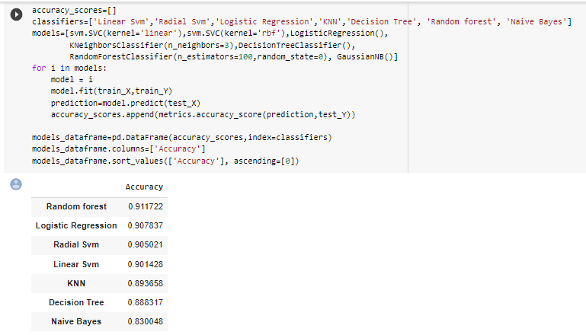
Evaluation Metrics Accuracy

Slide 69
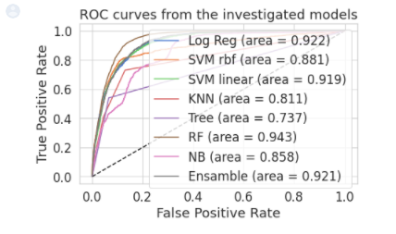
ROC Curve

Slide 70
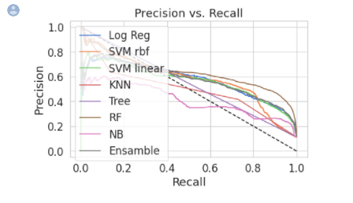
Precision Recall Curve

Slide 71
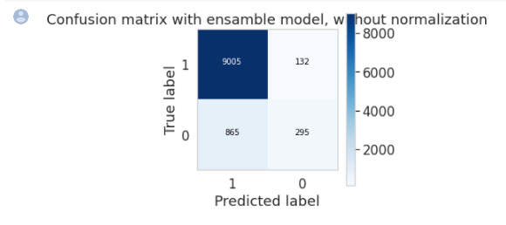
Confusion Matrix

